Slide 1
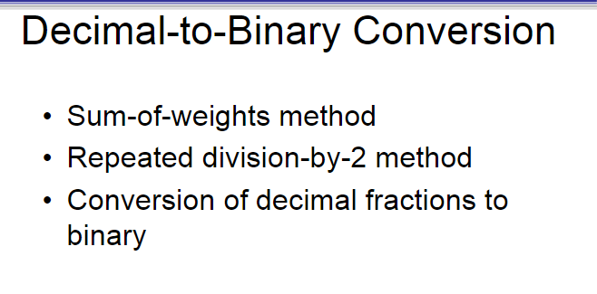

Slide 2
Sum-of-Weights Method
This method uses the fact that any decimal number can be expressed as a sum of powers of 2.
Example: Convert 13 to binary
Powers of 2: 8 (2³), 4 (2²), 1 (2⁰)
13 = 8 + 4 + 1 → 2³ + 2² + 2⁰
So, binary: 1101
8 4 2 1
13 =
1 1 0 1
9 =
1 0 0 1

Slide 3
Repeated Division-by-2 Method
Divide the number by 2 and record the remainder. Read remainders from bottom to top.
Example: Convert 13 to binary
Division | Quotient | Remainder
13 ÷ 2 | 6 | 1
6 ÷ 2 | 3 | 0
3 ÷ 2 | 1 | 1
1 ÷ 2 | 0 | 1
13 = 1 1 0 1

Slide 4
Conversion of Decimal Fractions to Binary
Multiply the fractional part by 2.
Take the integer part as a bit and continue with the fractional part.
Example: Convert 0.625 to binary
Multiply | Integer Part | Fraction
0.625 × 2 = 1.25 | 1 | 0.25
0.25 × 2 = 0.5 | 0 | 0.5
0.5 × 2 = 1.0 | 1 | 0.0
0.625 to binary =0.101

Slide 5
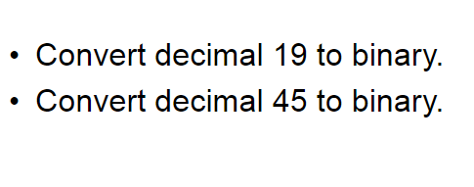
Convert 0.3125 to binary

Slide 6
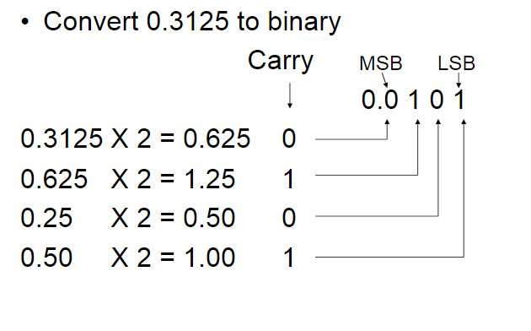
.
(MSB )Most Significant Bit
It is the leftmost bit in the binary number
Eg: 0. 0 1 0 1
(LSB )Least Significant Bit
It is the rightmost bit in the binary number.
Eg: 0. 0 1 0 1
MSB
LSB

Slide 7
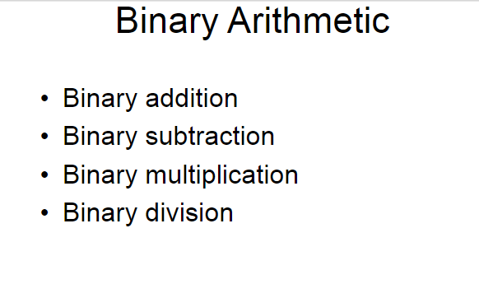

Slide 8
Binary Addition
0 + 0 = 0
0 + 1 = 1
1 + 0 = 1
1 + 1 = 10 (carry 1)
Binary Subtraction
0 - 0 = 0
1 - 0 = 1
1 - 1 = 0
0 - 1 = 1 (borrow 1)
)
Binary Multiplication
0 × 0 = 0
0 × 1 = 0
1 × 0 = 0
1 × 1 = 1
Binary Division
1100 ÷ 10 = ?
1100 (binary) = 12
10 (binary) = 2
12 ÷ 2 = 6 → 110 (binary)

Slide 9
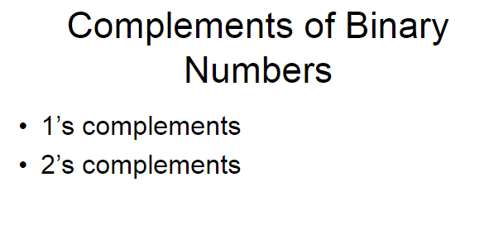

Slide 10
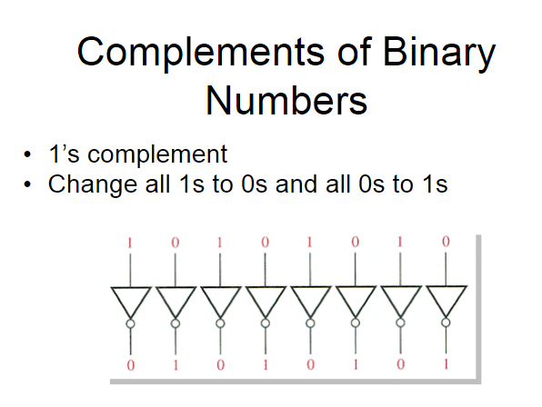
Example : 00010110
1’ s Complement : 0 0 0 1 0 1 1 0
1 1 1 0 1 0 0 1

Slide 11
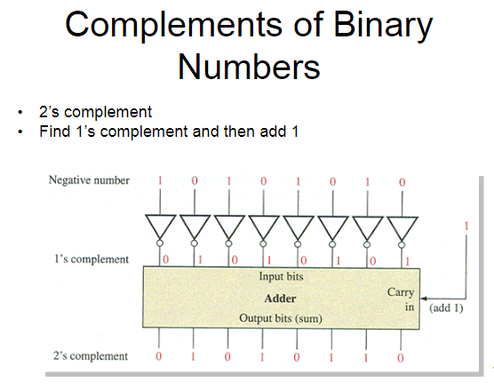

Slide 12
2’S COMPLEMENT
Steps to Find 2’s Complement:
Find the 1’s complement (flip all bits)
Add 1 to the result
Example: Convert 22 to -22 in 8-bit binary
Step 1: 22 in binary (8-bit) =
Division Step | Remainder
22 ÷ 2 | 0
11 ÷ 2 | 1
5 ÷ 2 | 1
2 ÷ 2 | 0
1 ÷ 2 | 1
=10110
= 00010110 (8 bits)

Slide 13
Step 2: Find 1’s complement (flip bits) =
00010110
11101001

Slide 14
Step 3: Find 2’s complement (Add 1) =
11101001
1 +
11101010

Slide 15
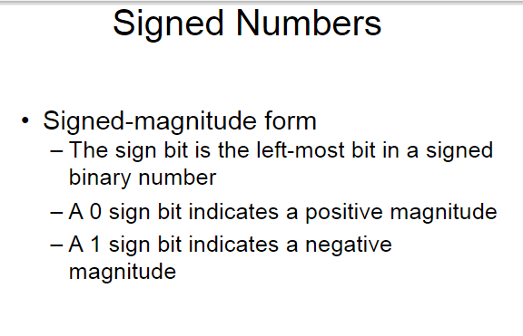

Slide 16
Signed-Magnitude Form
The leftmost bit is the sign bit.
The remaining bits represent the magnitude (absolute value).
Sign Bit | Meaning
0 | Positive (+)
1 | Negative (−)

Slide 17
Decimal | Binary (Signed-Magnitude) | Explanation
+5 | 0 101 | 0 → positive, 101 = 5
-5 | 1 101 | 1 → negative, 101 = 5
Sign Bit
Sign Bit

Slide 18
RANGE OF NUMBERS (N-BIT)
In n-bit signed-magnitude:
We can represent values from: –(2ⁿ⁻¹ – 1) to +(2ⁿ⁻¹ – 1)
0 has two forms:
0000 → +0
1000 → –0 (redundant)
For 4-bit: range is –7 to +7 (–7: 1111, +7: 0111)

Slide 22
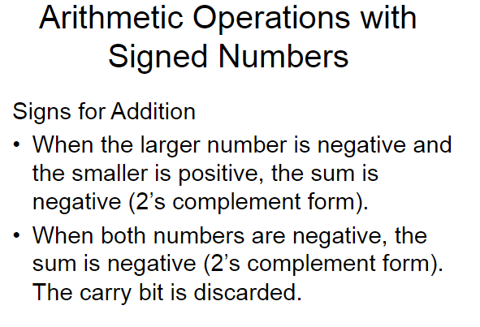

Slide 23
Addition
Rule: Add normally. If there is a carry out of the MSB, ignore it.
🔹 Example: (+5) + (–3)
+5 → 0101
–3 → 1101 (2’s complement of 0011)

